Slide 1

Data Analysis and Visualization using Pandas and Matplotlib
Hao Ji, Data Scientist
USC Center for Advanced Research Computing

Slide 2
Pandas
Matplotlib
Anaconda
Summary
Content
Section 1: Pandas
Pandas
Section 2: Matplotlib
Matplotlib
Section 3: Anaconda
Anaconda
Section 4: Summary
Summary

Slide 3
Pandas
Matplotlib
Anaconda
Summary
Introduction
Pandas: open source data analysis and manipulation tool in Python
By the end of this lecture, you should be able to:
Describe the value of Pandas to Data Science in Python
Highlight the key data structures of Pandas
Documentation Page: https://pandas.pydata.org/docs/user_guide/index.html

Slide 4
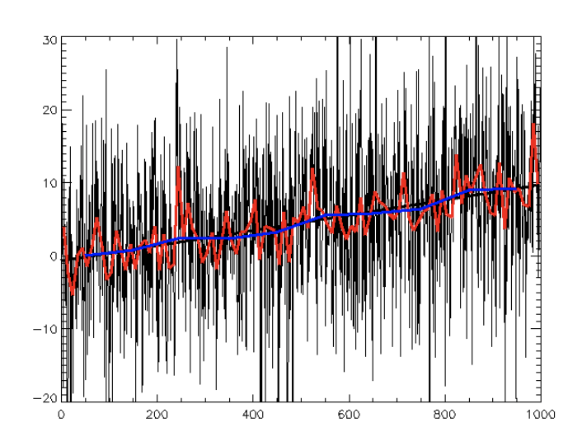
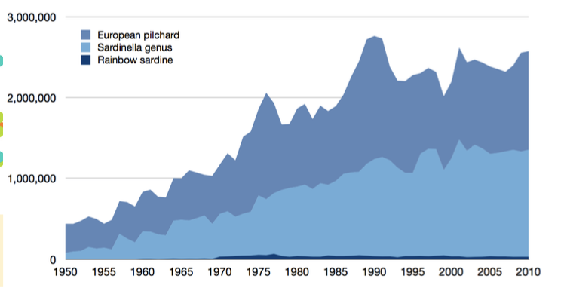
Pandas
Matplotlib
Anaconda
Summary
Benefits of Using Pandas
Key Benefits:
Data variety support
Data transformation & integration
Data visualization
Data Va
Time Series Data
Data Visualization

Slide 5
Pandas
Matplotlib
Anaconda
Summary
Pandas Data Structure: Series
1-dimensional labelled array
Supports many data types
Axis labels -> index (get and set values by index label)

Slide 6
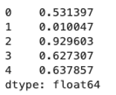
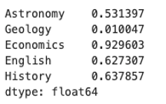
Pandas
Matplotlib
Anaconda
Summary
Pandas Data Structure: Series

Slide 7
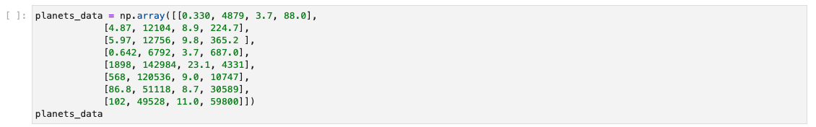
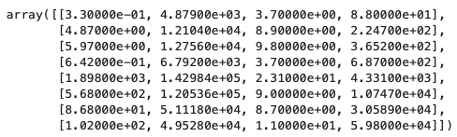
Pandas
Matplotlib
Anaconda
Summary
Pandas Data Structure: DataFrame

Slide 8
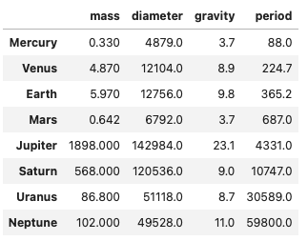
Pandas
Matplotlib
Anaconda
Summary
Pandas Data Structure: DataFrame

Slide 9
Pandas
Matplotlib
Anaconda
Summary
Data Integration
By the end of this lecture, you should be able to:
Describe the efficient and easy to use methods that pandas provides for importing data into memory
Identify functions such as ‘read_csv” for reading a CSV file into a DataFrame
Discuss about other data sources that pandas can directly import from

Slide 10
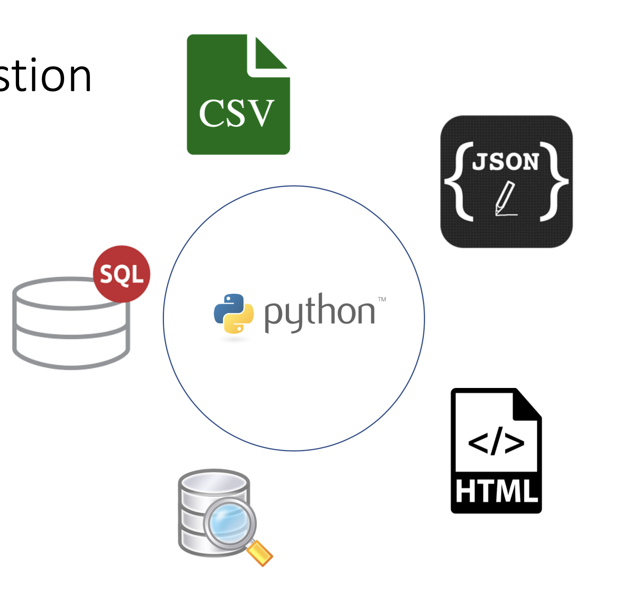
Pandas
Matplotlib
Anaconda
Summary
Pandas: Data Ingestion

Slide 11
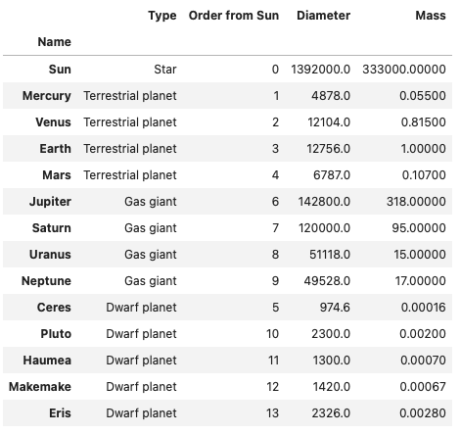
Pandas
Matplotlib
Anaconda
Summary
Pandas: Data Ingestion
read_csv:

Slide 12
Pandas
Matplotlib
Anaconda
Summary
Pandas: Descriptive Statistics
By the end of this section, you should be able to:
Describe the capabilities of Pandas for performing statistical analysis on data
Leverage frequently used functions such as describe()
Explore other statistical functions in Pandas, which is constantly evolving

Slide 13
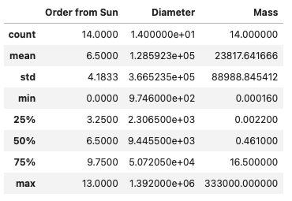
Pandas
Matplotlib
Anaconda
Summary
Pandas Data Structure: DataFrame

Slide 14
Pandas
Matplotlib
Anaconda
Summary
Pandas Data Structure: DataFrame
General functions for calling these function is data_frame.func()
Func = min()
Func= max()
Func = std()
Func = mode()
Func = median()
Func = any()
Func = all()

Slide 15
Pandas
Matplotlib
Anaconda
Summary
Pandas: Data Cleaning
By the end of this section, you should be able to:
Explain why there is a need to clean data
Describe data cleaning as an activity
Leverage key methods pandas provides for data cleaning

Slide 16
Pandas
Matplotlib
Anaconda
Summary
Pandas: Data Cleaning
Real-world data is messy!
Missing values
Outliers in the data
Invalid data (e.g. negative values for age)
NaN value (np.nan)
None value

Slide 17
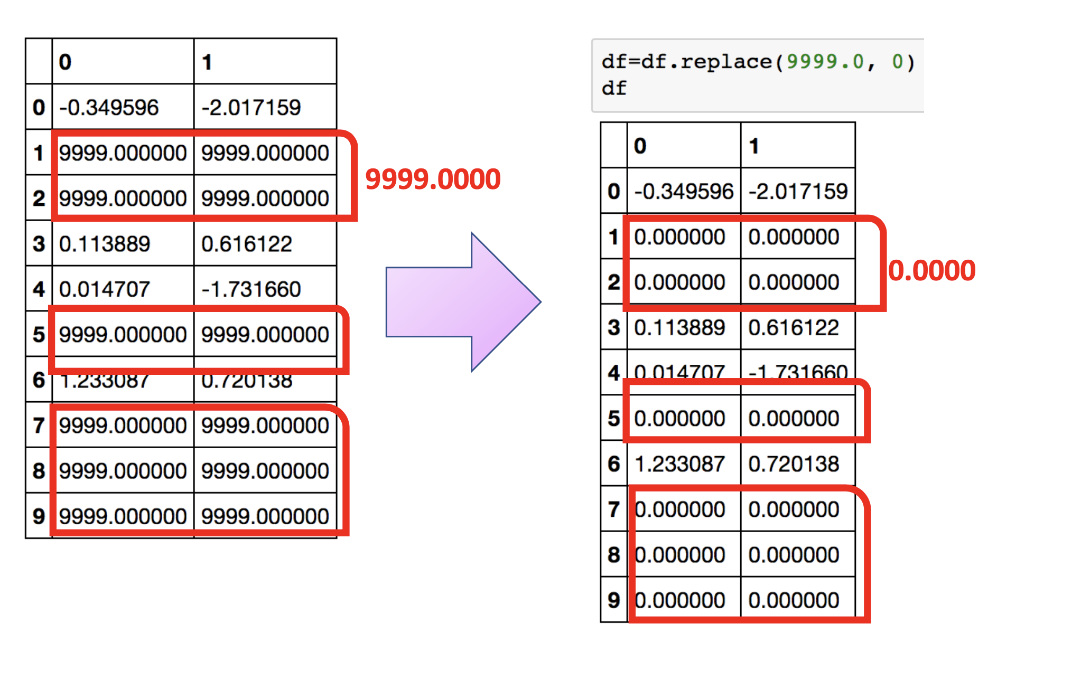
Pandas
Matplotlib
Anaconda
Summary
Pandas: Data Cleaning
df.replace()

Slide 18
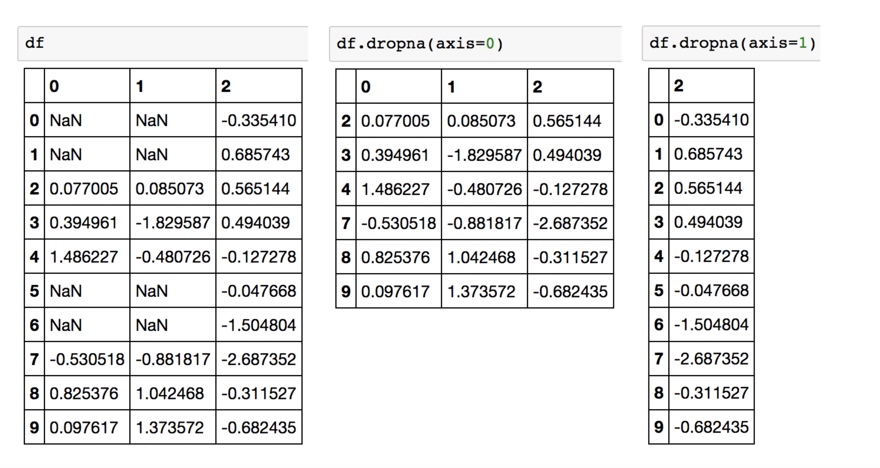
Pandas
Matplotlib
Anaconda
Summary
Pandas: Data Cleaning
df.dropna()

Slide 19
Pandas
Matplotlib
Anaconda
Summary
Pandas: Data Visualization
By the end of this section, you should be able to:
Identify key plotting functions of Pandas
Recognize the ease of utilization of Pandas methods for visualization

Slide 20
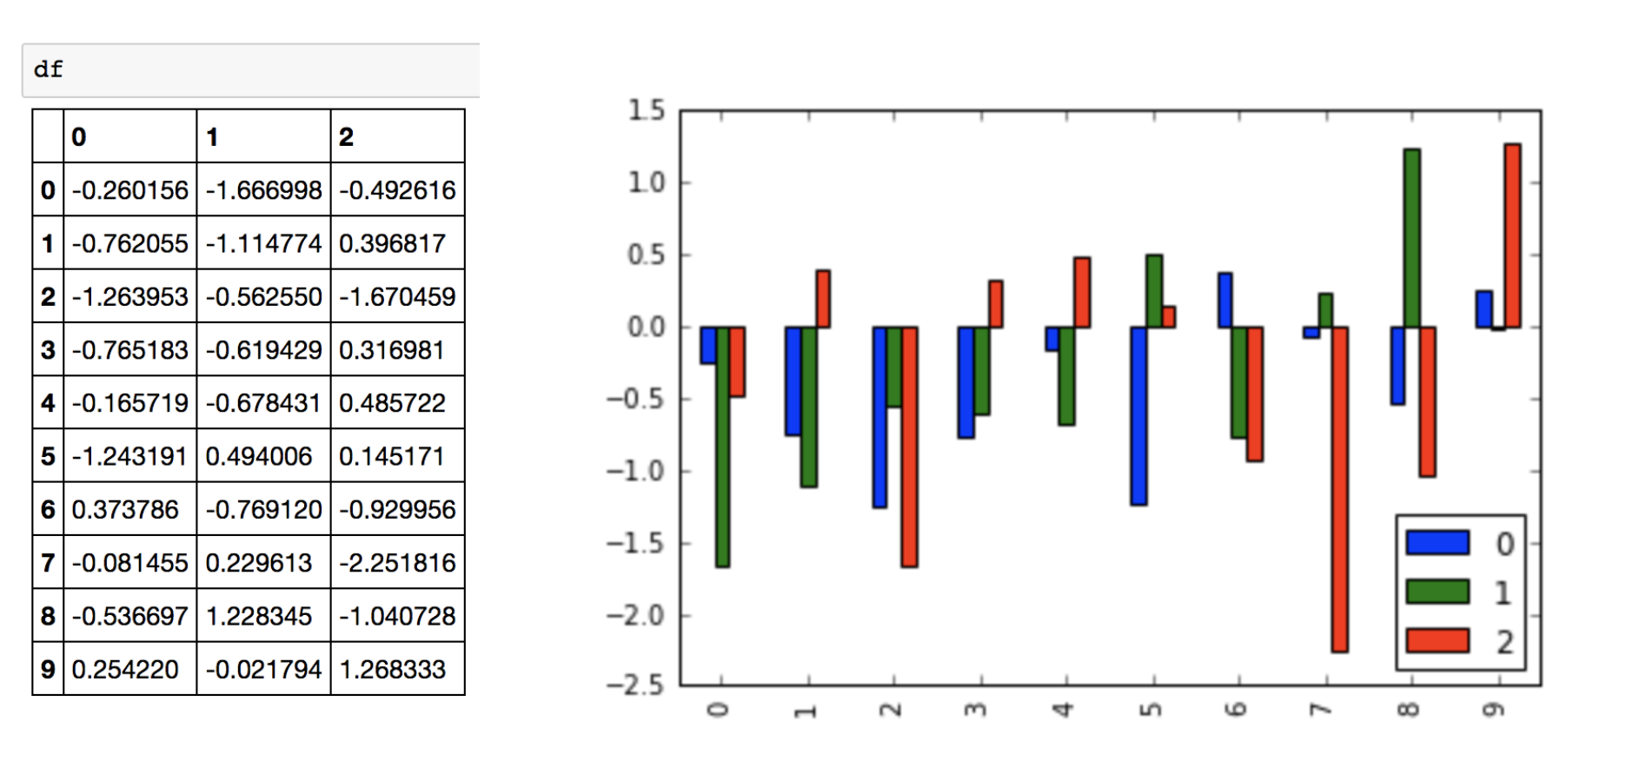
Pandas
Matplotlib
Anaconda
Summary
Pandas: Data Visualization
Comand: df.plot.bar()

Slide 21
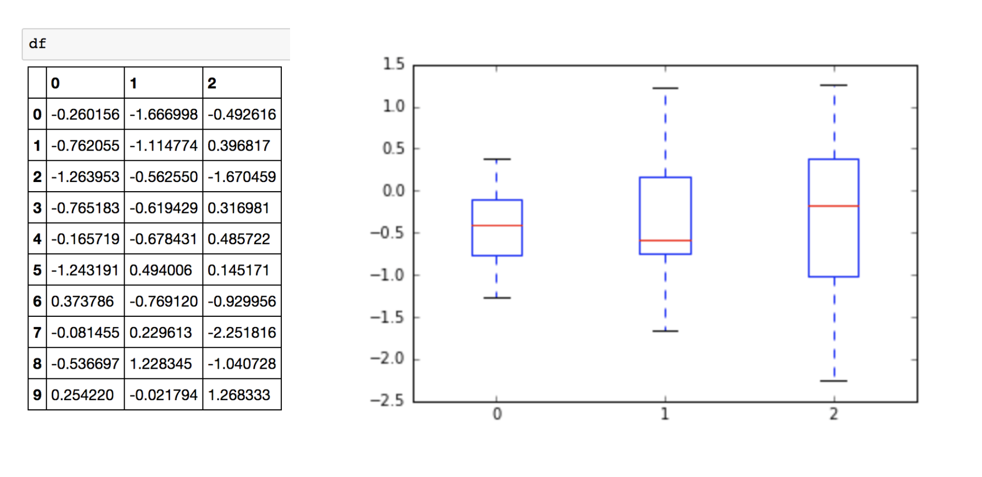
Pandas
Matplotlib
Anaconda
Summary
Pandas: Data Visualization
Comand: df.plot.box()

Slide 22
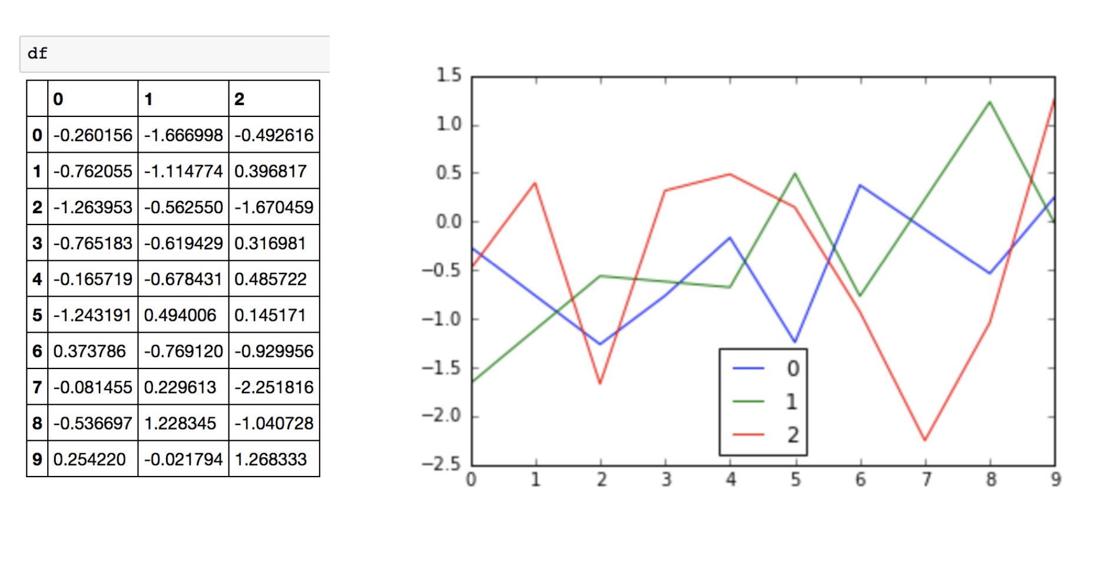
Pandas
Matplotlib
Anaconda
Summary
Pandas: Data Visualization
Comand: df.plot()

Slide 23
Pandas
Matplotlib
Anaconda
Summary
Pandas: Frequent data operations
By the end of this section, you should be able to:
Handpick data (rows or columns) in a DataFrame using Pandas methods
Add or Delete rows or columns in a DataFrame
Perform aggregation operations / group by

Slide 24
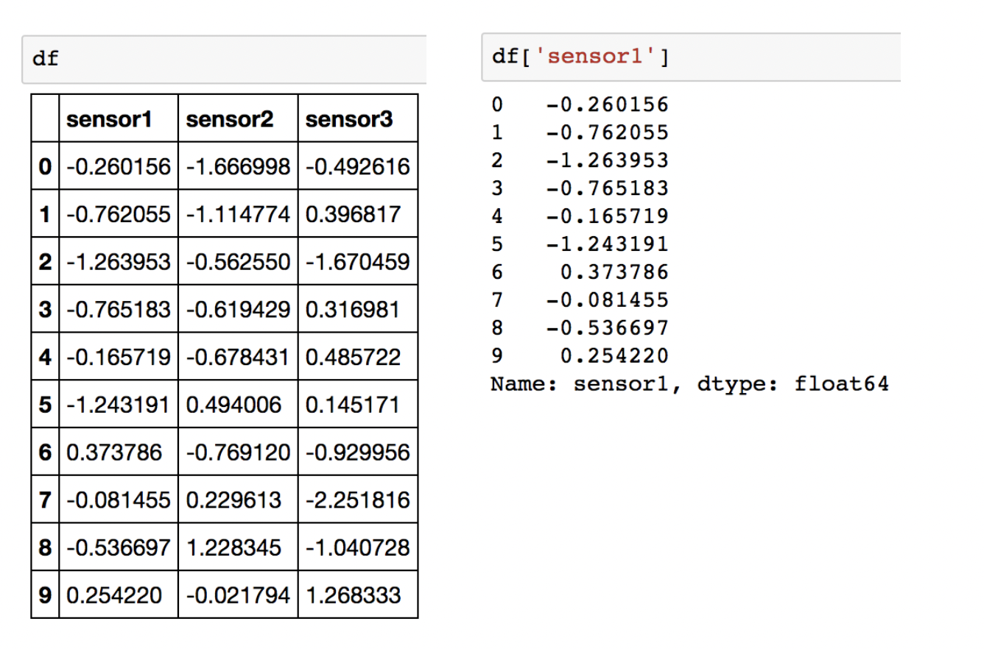
Pandas
Matplotlib
Anaconda
Summary
Pandas: Frequent data operations
Slice out columns:

Slide 25
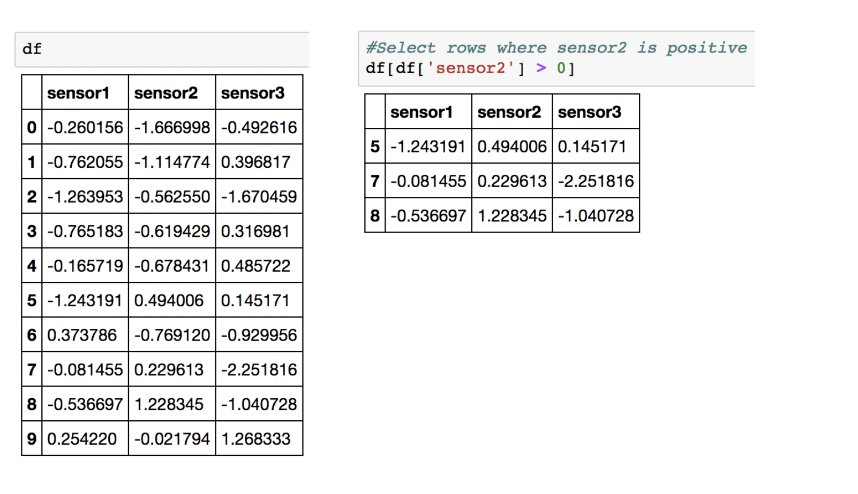
Pandas
Matplotlib
Anaconda
Summary
Pandas: Frequent data operations
Filter out rows:

Slide 26
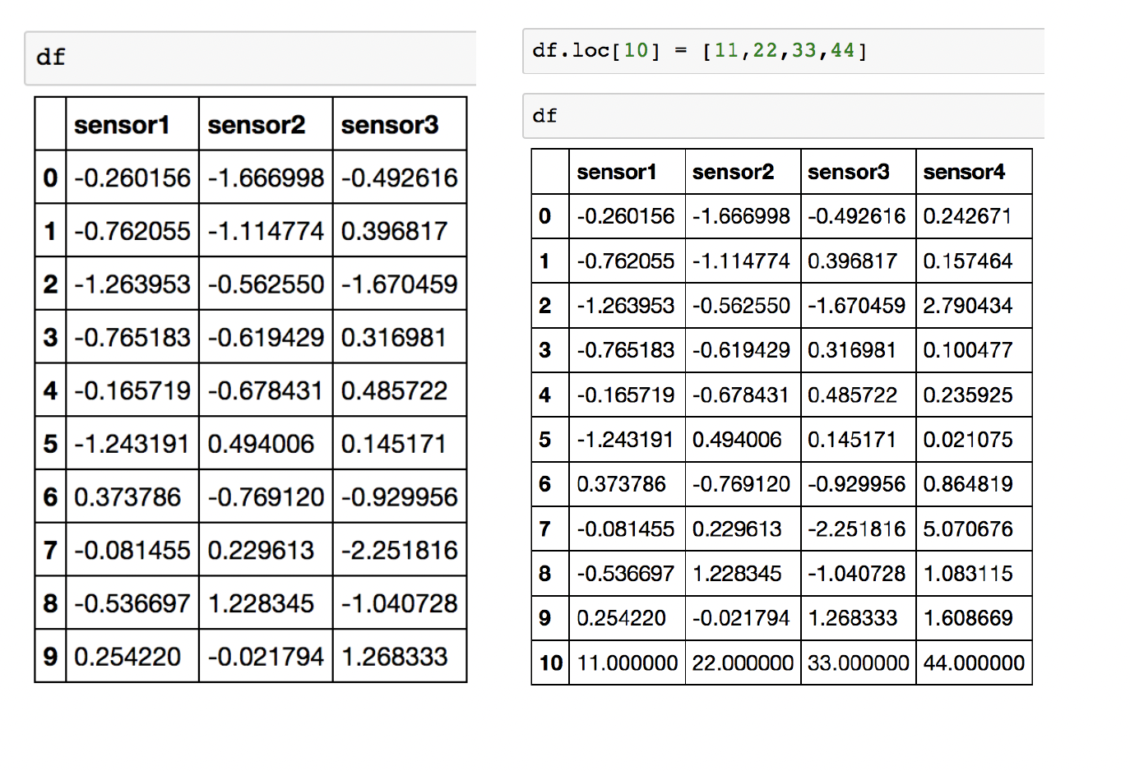
Pandas
Matplotlib
Anaconda
Summary
Pandas: Frequent data operations
Add a new row:

Slide 27
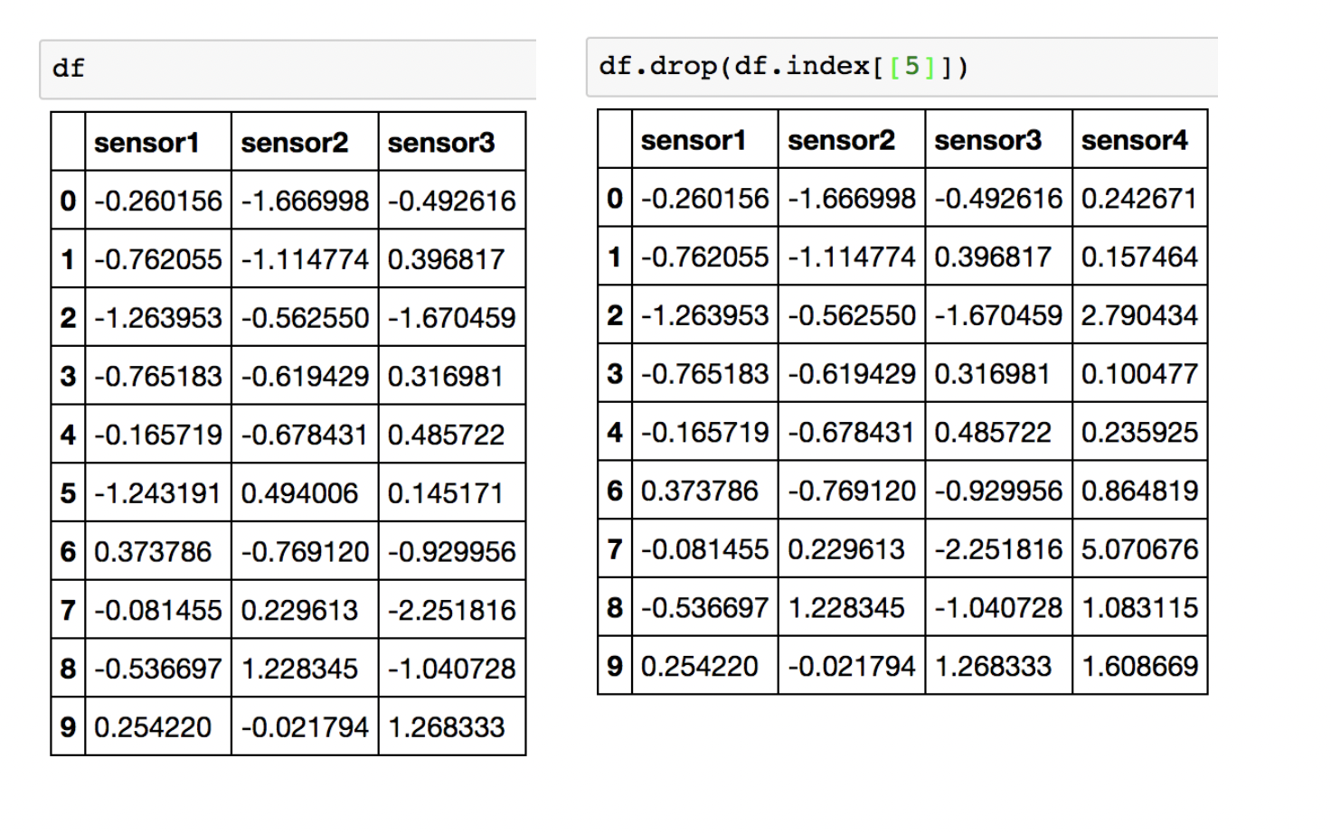
Pandas
Matplotlib
Anaconda
Summary
Pandas: Frequent data operations
Delete a row:

Slide 28
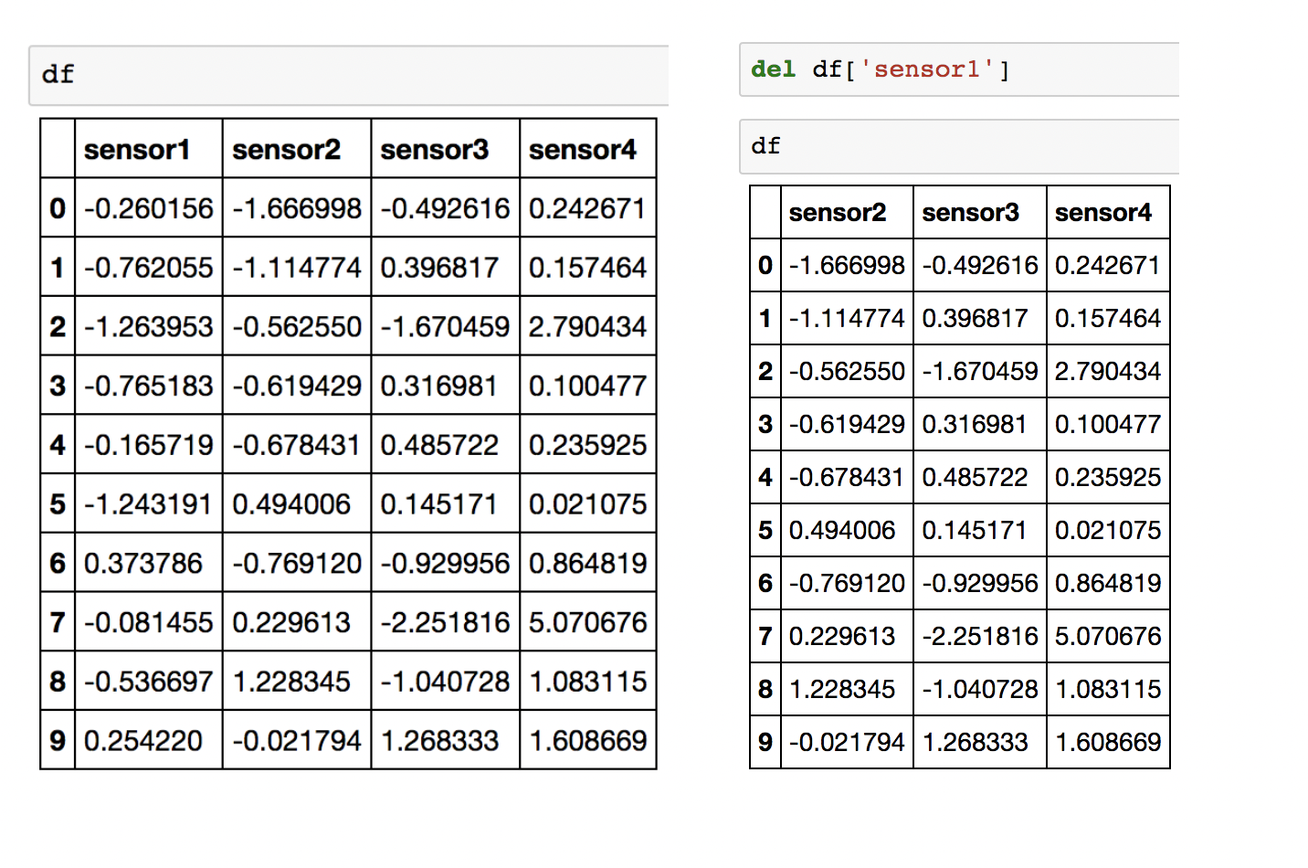
Pandas
Matplotlib
Anaconda
Summary
Pandas: Frequent data operations
Delete a column:

Slide 29
Pandas
Matplotlib
Anaconda
Summary
Pandas: Merging DataFrames
By the end of this section, you should be able to:
Explain that data is usually distributed across different locations and tables
Combine data from distinct DataFrames to obtain the big picture
Distinguish among different ways to combine datasets

Slide 30
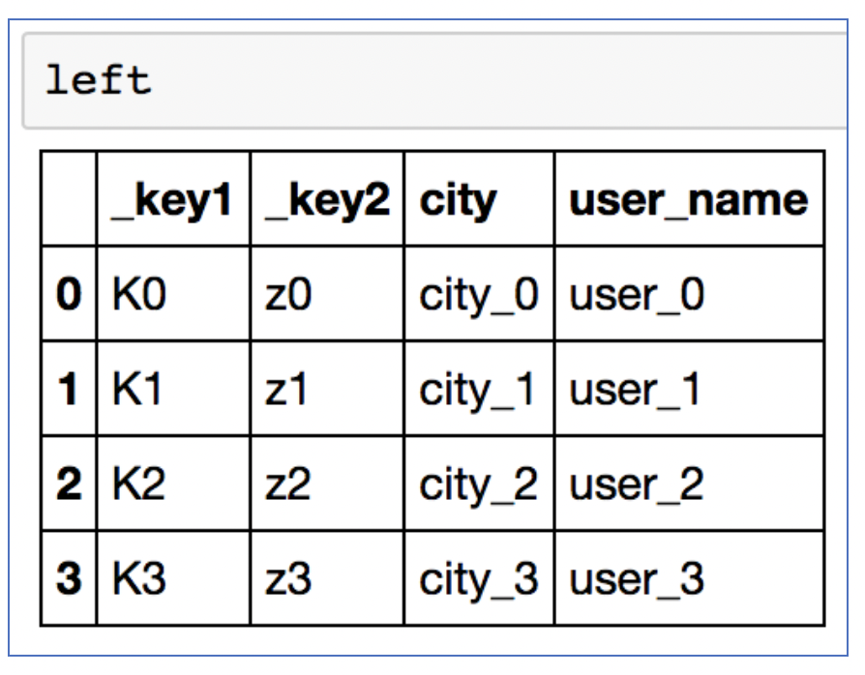
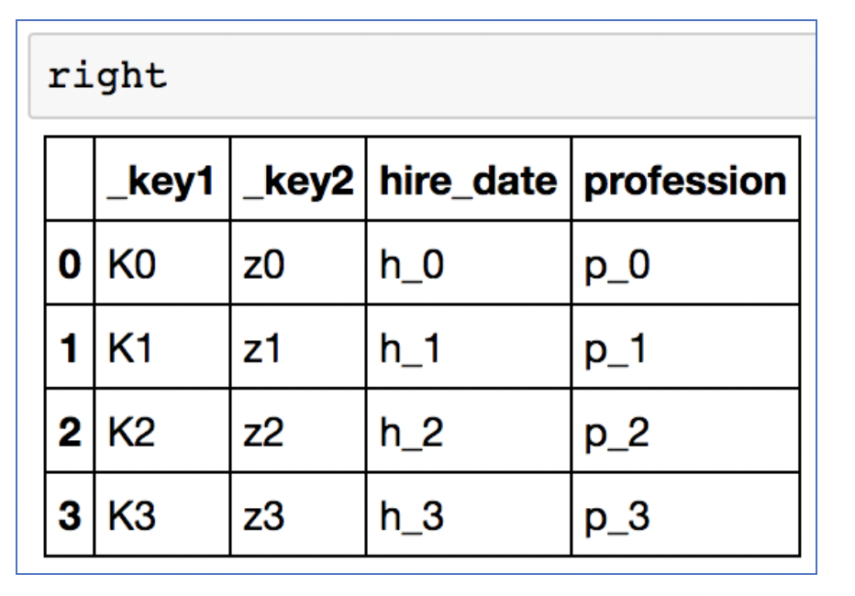
Pandas
Matplotlib
Anaconda
Summary
Pandas: Merging DataFrames
Example Dataframes

Slide 31
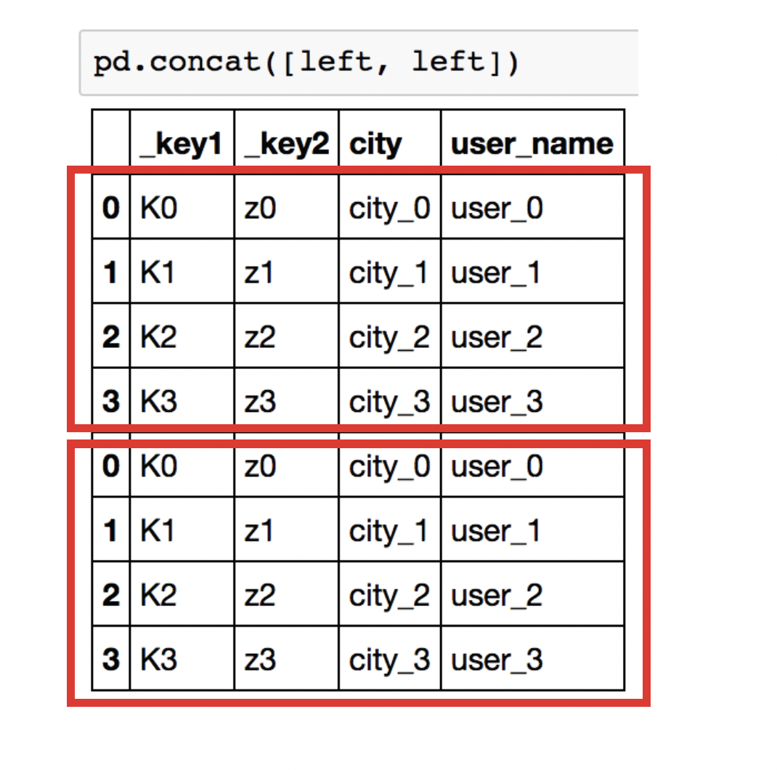
Pandas
Matplotlib
Anaconda
Summary
Pandas: Merging DataFrames
Pandas.concat(): stack dataframes

Slide 32
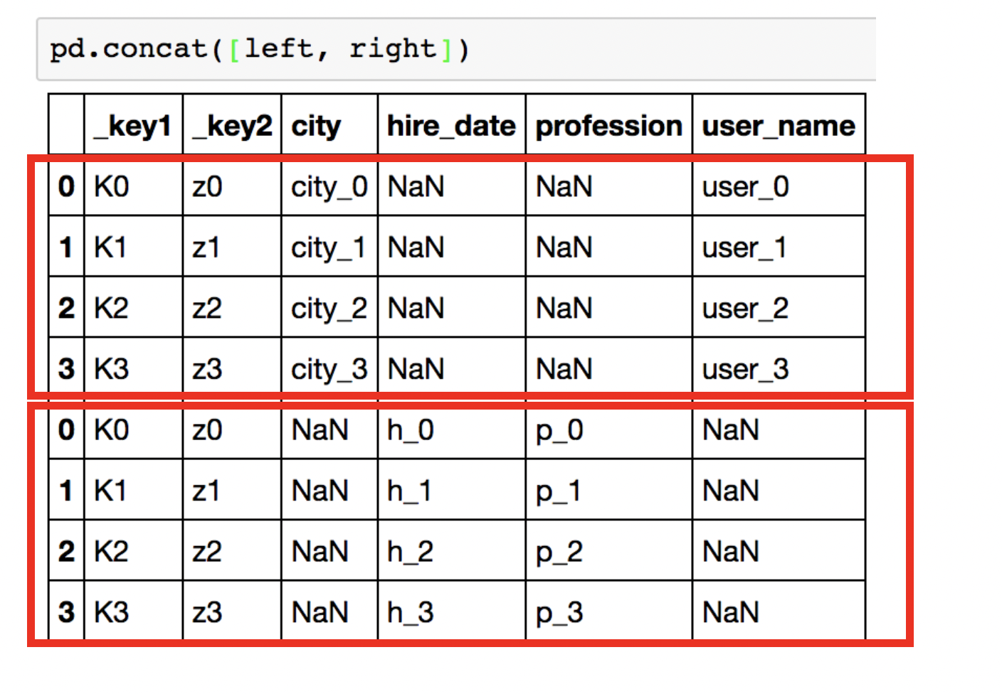
Pandas
Matplotlib
Anaconda
Summary
Pandas: Merging DataFrames

Slide 33
Pandas
Matplotlib
Anaconda
Summary
Pandas: Summary
Data Cleaning
read_csv()
convert CSV file to Pandas Dataframe
Data Ingestion
Statistical Analysis
Merging Dataframe
Data Visualization
Data Transformation

Slide 34
Pandas
Matplotlib
Anaconda
Summary
Pandas: Case Study
Data Cleaning
Detection: isnull(), any()
Cleaning: dropna()
Data Ingestion
Statistical Analysis
Merging Dataframe
Data Visualization
Data Transformation

Slide 35
Pandas
Matplotlib
Anaconda
Summary
Pandas: Case Study
Data Cleaning
Data Ingestion
Statistical Analysis
Describe()
Any(), all()
Merging Dataframe
Data Visualization
Data Transformation

Slide 36
Pandas
Matplotlib
Anaconda
Summary
Pandas: Case Study
Data Cleaning
Data Ingestion
Statistical Analysis
Merging Dataframe
Data Visualization
Inline plotting
Histograms
Boxplots
Data Transformation

Slide 37
Pandas
Matplotlib
Anaconda
Summary
Pandas: Case Study
Data Cleaning
Data Ingestion
Statistical Analysis
Merging Dataframe
Data Visualization
Slicing columns
Filtering rows
Groupby()
Data Transformation

Slide 38
Pandas
Matplotlib
Anaconda
Summary
Pandas: Case Study
Data Cleaning
Data Ingestion
Statistical Analysis
Merging Dataframe
Data Visualization
Concat()
Append()
Data Transformation

Slide 39
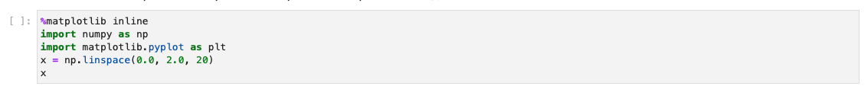
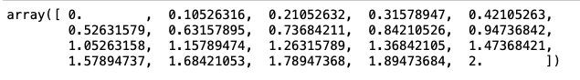
Matplotlib
Pandas
Matplotlib
Anaconda
Summary
1. 2D plotting single line figure

Slide 40
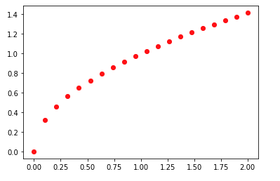
Matplotlib
Pandas
Matplotlib
Anaconda
Summary

Slide 41
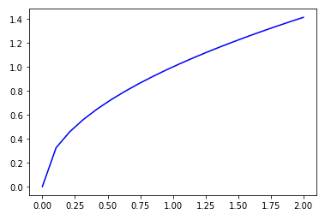
Matplotlib
Pandas
Matplotlib
Anaconda
Summary

Slide 42
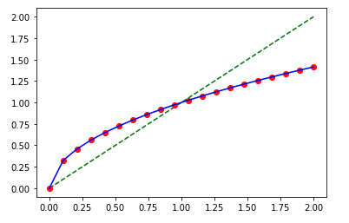
Matplotlib
Pandas
Matplotlib
Anaconda
Summary
2. Multiple lines on the same figure

Slide 43
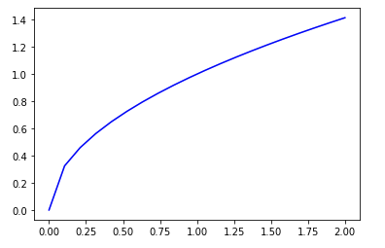
Matplotlib
Pandas
Matplotlib
Anaconda
Summary
3. Save a figure to a file

Slide 44
Pandas
Matplotlib
Anaconda
Summary
Using Anaconda & Juypyter Kernel on CARC
Conda Environment
Jupyter Kernel
OpenOnDemand
Jupyter Notebook

Slide 45
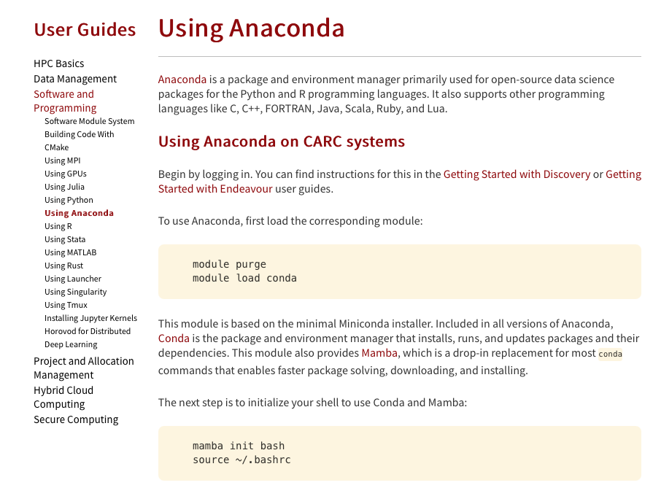
Pandas
Matplotlib
Anaconda
Summary
Using Anaconda on CARC
Anaconda: package and environment manager primarily used for open-source data science packages for the Python and R programming languages.
https://www.carc.usc.edu/user-information/user-guides/software-and-programming/anaconda
salloc
mamba create -n 01-23
mamba activate 01-23
mamba install python
mamba install pandas
mamba install matplotlib

Slide 46
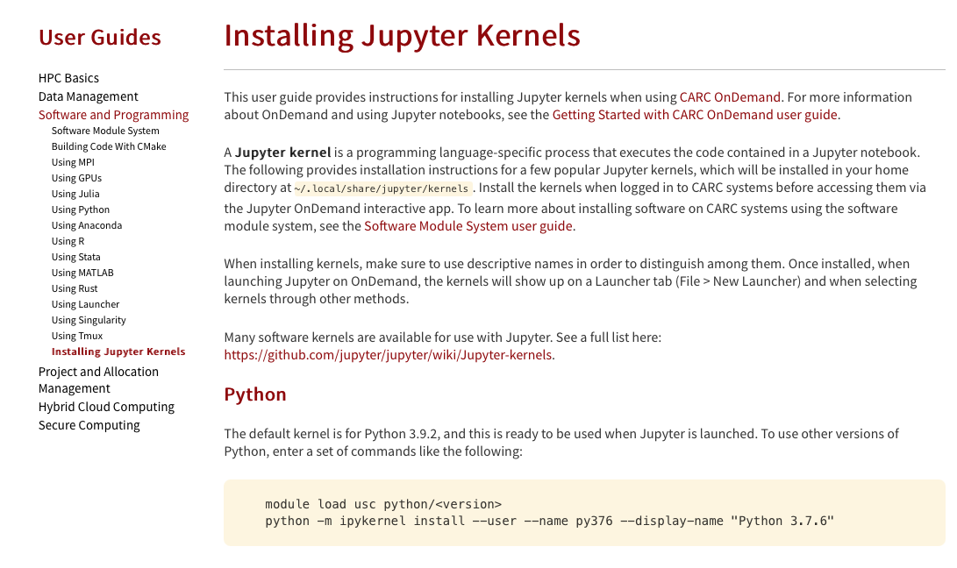
Pandas
Matplotlib
Anaconda
Summary
Creating Jupyter Kernel
A Jupyter kernel is a programming language-specific process that executes the code contained in a Jupyter notebook.
https://www.carc.usc.edu/user-information/user-guides/software-and-programming/jupyter-kernels

Slide 47
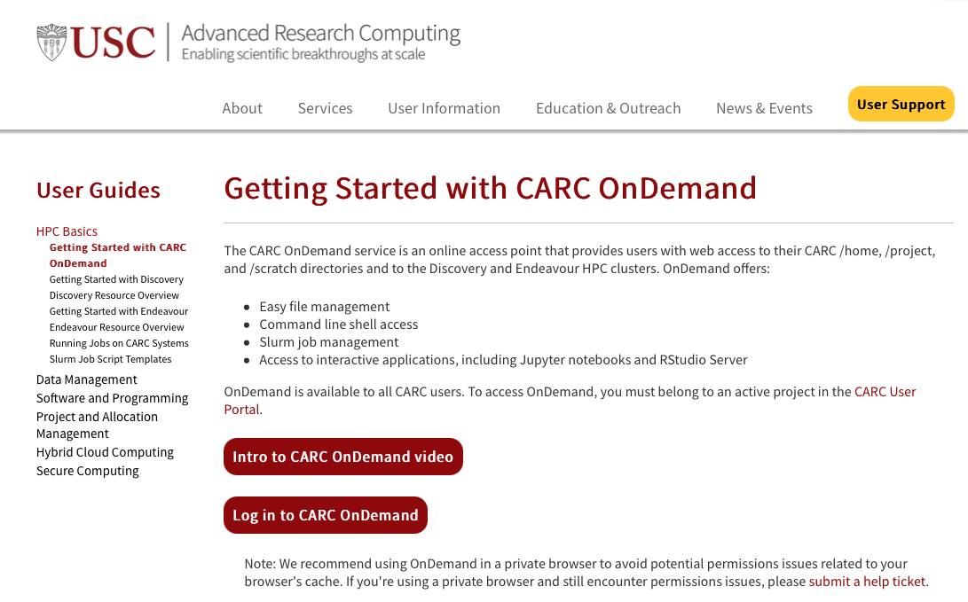
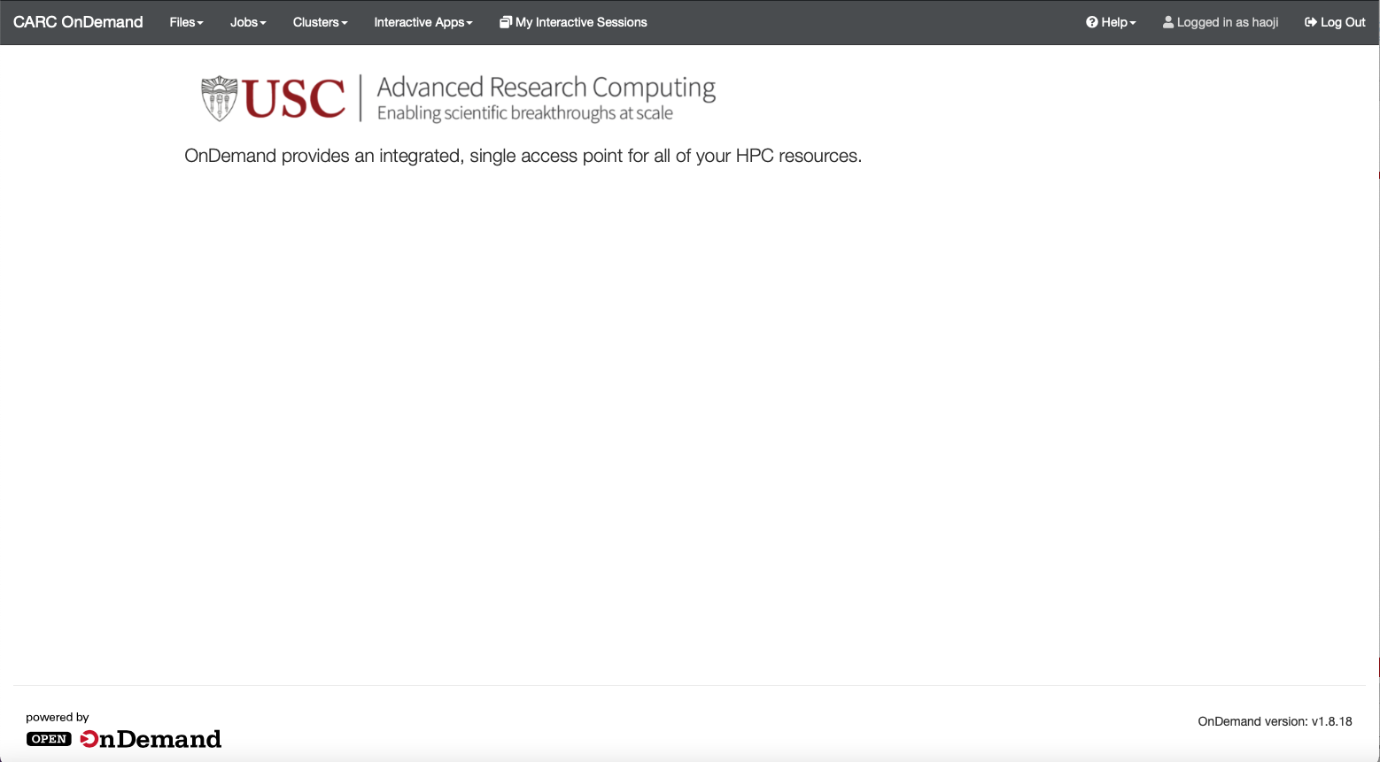
CARC Ondemand
Pandas
Matplotlib
Anaconda
Summary
Web Address: https://carc-ondemand.usc.edu

Slide 48
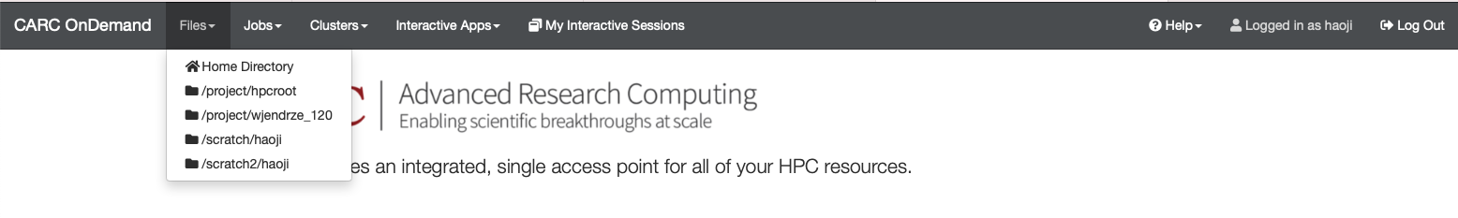
CARC Ondemand
Pandas
Matplotlib
Anaconda
Summary

Slide 49
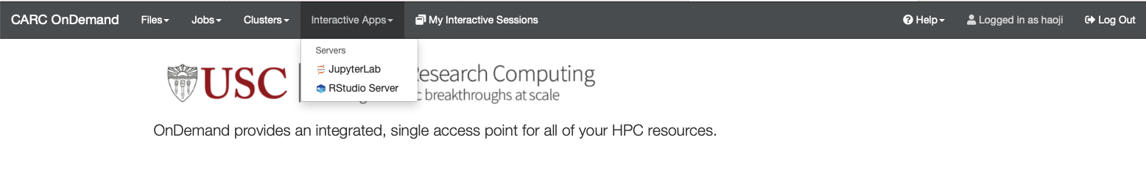
CARC Ondemand
Pandas
Matplotlib
Anaconda
Summary

Slide 50
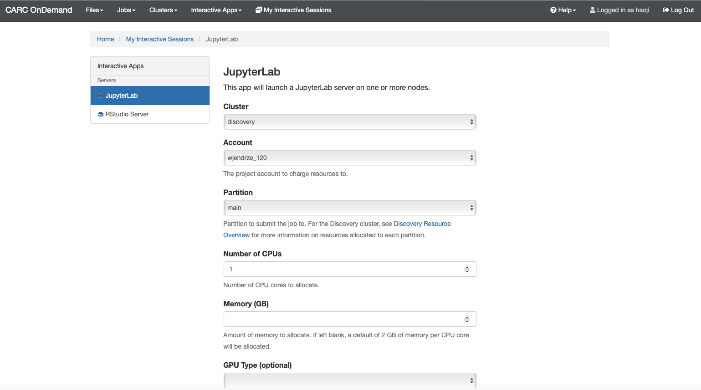
CARC Ondemand
Pandas
Matplotlib
Anaconda
Summary
https://www.carc.usc.edu/user-information/user-guides/hpc-basics/discovery-resources

Slide 51
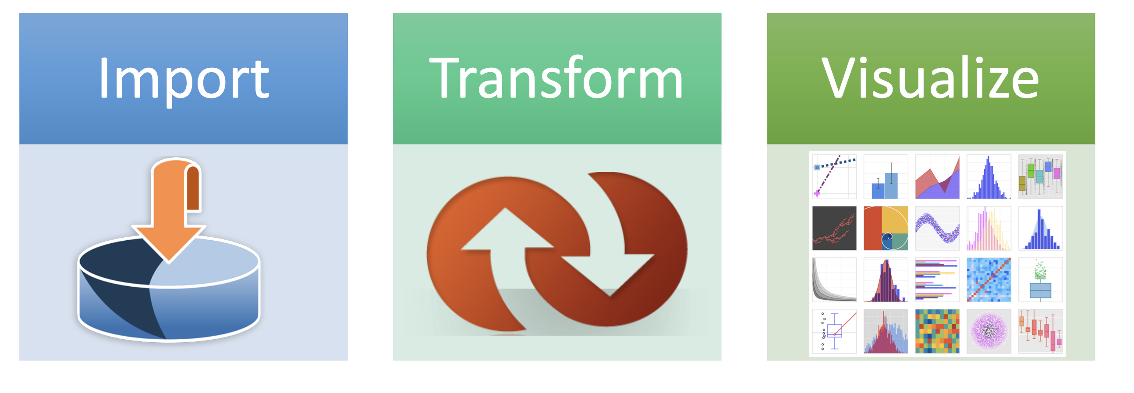
Pandas
Matplotlib
Anaconda
Summary
Summary

